Slide 1

COMP90050
Advanced Database Systems
Winter Semester, 2023
Lecturer: Farhana Choudhury (PhD)
Week 2 part 4-5

Slide 2
Core Concepts of Database management system
Efficiency
- Disks and I/O bandwidth
- Main memory
- Type of architecture
Database performance metrics
Hardware
Software/ DB tuning
- Types of DB
- Indexing
- Query optimisation
Efficiency/speed
Effectiveness
Effectiveness
Concurrent users
Security & Reliability
Transactions
Reliability
Crash recovery
Fault tolerance
Data duplication

Slide 3
What needs to be efficient
DBMS must support:
–insert/delete/modify record
–read a particular record (specified using record id)
–scan all records (possibly with some conditions on the
records to be retrieved), or scan a range of records

Slide 4
A key choice to make
DBMS admin generally creates indices to allow almost direct access to individual items
These are also good during join operations
  if there is a join condition that restricts the number of items to be joined in a table

Slide 5
Topics
What is indexing
Different types of indexes
Usage of indexes
Indexing in practice

Slide 6
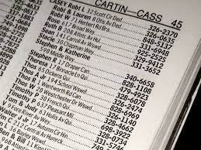
Indexing is Critical for Efficiency
Indexing mechanisms used to speed up access to desired data in a similar way to look up a phone book or dictionary
Search Key - attribute or set of attributes used to look up records/rows in a system like an ID of a person

Slide 7
Indexing is Critical for Efficiency
An index file consists of records (called index entries) of the form search-key, pointer to where data is
Index files are typically much smaller than the original data files and many parts of it are already in memory

Slide 8
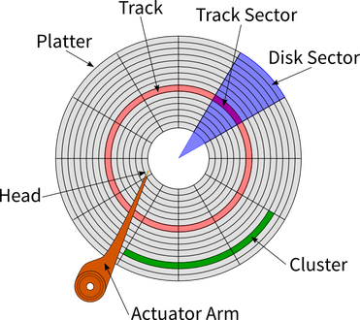
What becomes faster?
Disk access becomes faster through:
  records with a specified value in the attribute accessed with minimal disk accesses
  or records with an attribute value falling in a specified range of values can be retrieved with a single seek and then consecutive sequential reads

Slide 9
Indexing is Critical for Efficiency
Insertion time to index is also important
Deletion time is important as well
No big index rearrangement after insertion and deletion
Space overhead needs to be considered for the index itself
No single indexing technique is the best. Rather, each technique is best suited to particular applications.

Slide 10
Indexing is Critical for Efficiency
Two basic kinds of indices based on search keys:
  Ordered indices: search keys are stored in some order
  Hash indices: search keys are distributed hopefully uniformly across “buckets” using a “function”

Slide 11
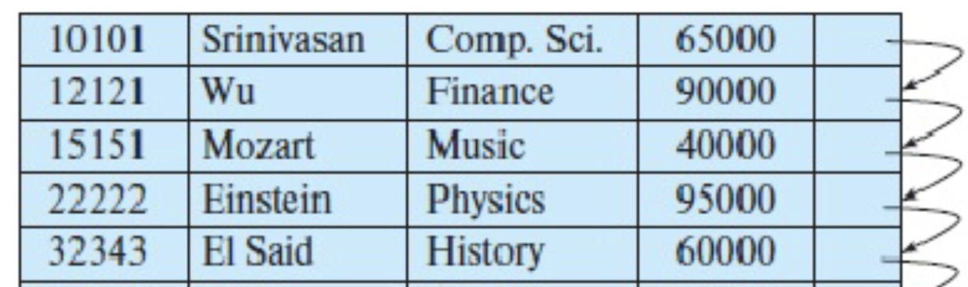
Ordered Index
The records in the indexed file may themselves be stored in some sorted order
Clustering index/ Primary index: in a sequentially ordered file, the index whose search key specifies the sequential order of the file
  The search key of a primary index is usually but not necessarily the primary key

Slide 12
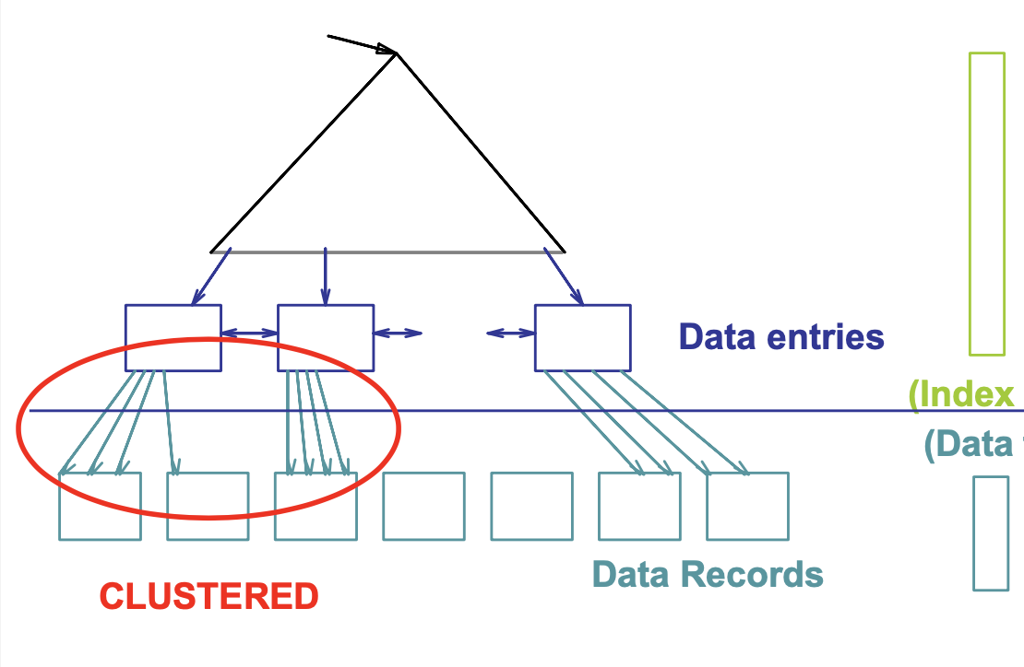
Ordered Index
The records in the indexed file may themselves be stored in some sorted order
Clustering index/ Primary index: in a sequentially ordered file, the index whose search key specifies the sequential order of the file

Slide 13
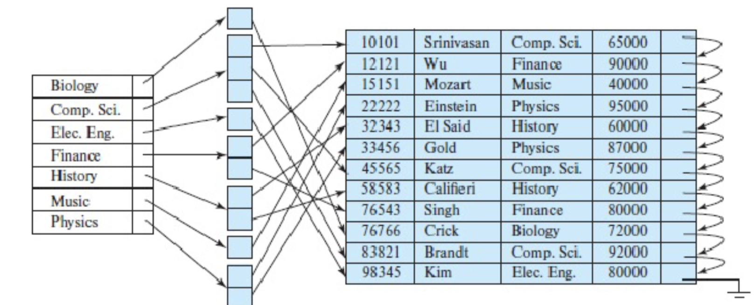
Ordered Index
Non-clustering index/ Secondary index: an index whose search key specifies an order different from the sequential order of the file
Secondary indices improve the performance of queries that use keys other than the search key of the clustering index.

Slide 14
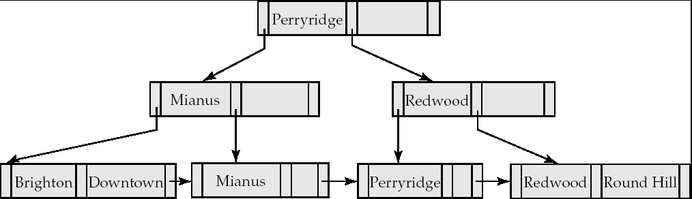
The most popular in DBMS: B+trees
Why need them:
  Keeping files in order for fast search ultimately degrades as file grows, since many overflow blocks get created.
  So binary search on ordered files cannot be done.
  Periodic reorganization of entire file is required to achieve this.
Advantage of B⁺-tree index files:
  automatically reorganizes itself with small, local, changes, in the face of insertions and deletions.
  Reorganization of entire file is not required to maintain performance.

Slide 15
B+trees Contd
Similar to Binary tree in many aspects but the fan out is much higher
Disadvantage of B⁺-trees:
  Extra insertion and deletion overhead and space overhead
Advantages of B⁺-trees outweigh disadvantages for DBMSs
  B⁺-trees are used extensively

Slide 16
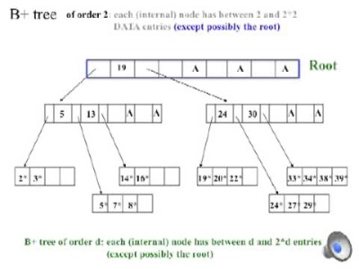
B+tree structure
Video link: https://youtu.be/CYKRMz8yzVU

Slide 17
How is a B+tree defined?
It is similar to a binary tree in concept but with a fan out that is defined through a number n
All paths from root to leaf are of the same length (depth)
Each node that is not a root or a leaf has between ⎡n/2⎤ and n children
A leaf node has between ⎡(n–1)/2⎤ and n–1 values
Special cases:
  If the root is not a leaf, it has at least 2 children.
  If the root is a leaf (that is, there are no other nodes in the tree), it can have between 0 and (n–1) values.

Slide 18
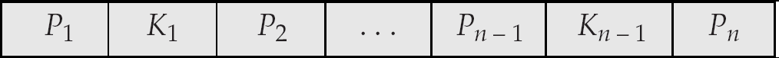
A Single Node
Typical node
  K_{i} are the search-key values
  P_{i} are pointers to children (for non-leaf nodes) or pointers to records or buckets of records (for leaf nodes)
The search-keys in a node are ordered
K₁ < K₂ < K₃ < . . . < K_{n–1}
NOTE: Most of the higher level nodes of a B+tree would be in main memory already!

Slide 19
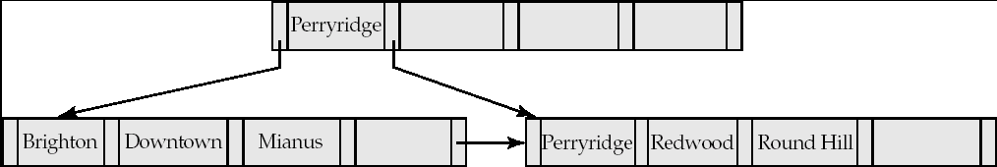
Example B+tree
B⁺-tree for account file (n = 5)
Leaf nodes must have between 2 and 4 values
(⎡(n–1)/2⎤ and n –1, with n = 5).
Non-leaf nodes other than root must have between 3 and 5 children (⎡(n/2⎤ and n with n =5).
Root must have at least 2 children.

Slide 20
How to run a query fast then?
Finding all records with a search-key value of k.
  N=root initially
  Repeat
    Examine N for the smallest search-key value > k.
    If such a value exists, assume it is K_{i}. Then set N = P_{i}
    Otherwise k ≥ K_{n–1}. Set N = P_{n} . Follow pointer.
    Until N is a leaf node
  If for some i, key K_{i} = k follow pointer P_{i} to the desired record or bucket.
  Else no record with search-key value k exists.
Example

Slide 21
Recall: running a query on B+trees?
Finding all records with a search-key value of k.
  N=root initially
  Repeat
    Examine N for the smallest search-key value > k.
    If such a value exists, assume it is K_{i}. Then set N = P_{i}
    Otherwise k ≥ K_{n–1}. Set N = P_{n} . Follow pointer.
    Until N is a leaf node
  If for some i, key K_{i} = k follow pointer P_{i} to the desired record or bucket.
  Else no record with search-key value k exists.
Example
Perryridge

Slide 22
A full view of a B⁺-Tree

Slide 23
Metrics
If there are K search-key values in the file, the height of the tree is no more than ⎡log_{⎡n/2⎤}(K)⎤ and it would be balanced
A node is generally the same size as a disk block, typically 4 kilobytes
  and n is typically around 100 (40 bytes per index entry).
With 1 million search key values and n = 100
  log₅₀(1,000,000) = 4 nodes are accessed in a lookup.
Contrast this with a balanced binary tree with 1 million search key values — around 20 nodes are accessed in a lookup
  above difference is significant since every node access may need a disk I/O, costing around 20 milliseconds

Slide 24
A Quick Visual Comparison

Slide 25
Range Queries on B⁺-Trees
Range queries find all records with search key values in a given range

Slide 26
B⁺-Tree Insertion
B⁺-Tree before and after insertion of “Adams”

Slide 27
B⁺-Tree Insertion
B⁺-Tree before and after insertion of “Lamport”

Slide 28
Examples of B⁺-Tree Deletion
Before and after deleting “Srinivasan”
Deleting “Srinivasan” causes merging of under-full leaves

Slide 29
Examples of B⁺-Tree Deletion
Before and after deleting “Singh” and “Wu”
Leaf containing Singh and Wu became underfull, and borrowed a value Kim from its left sibling
Search-key value in the parent changes as a result

Slide 30
Example of B⁺-tree Deletion
Before and after deletion of “Gold”
Node with Gold and Katz became underfull, and was merged with its sibling
Parent node becomes underfull, and is merged with its sibling
  Value separating two nodes (at the parent) is pulled down when merging
Root node then has only one child, and is deleted

Slide 31
B⁺-Tree File Organization
B⁺-Tree File Organization:
  Leaf nodes in a B⁺-tree file organization store records, instead of pointers to children
  Helps keep data records clustered (ordered) even when there are insertions/deletions/updates
  Insertion and deletion or records are handled in the same way as insertion and deletion of entries in a B⁺-tree index.

